Slide 1
Cell Ontology Editor Training 2020
Intro to Ontologies
David Osumi-Sutherland
Samples, Phenotype and Ontologies group, EMBL-EBI
Current Projects include:
uPheno, Virtual Fly Brain, Fly Cell Atlas,
Brain Data Stanardization Project (Allan)

Slide 2
Why do we need ontologies?
Describing the problem
Notes:
Outline:
Why do we need ontologies
CVs
Heirarchical CVs
Synonyms
Ontologies
- types of relations
- multiple inheritance (managed)
Annotation:
- Grouping
- Being precisely vague - Choosing the most precise term possible
What is Uberon?
Relationship to CL
The challenge of getting human terms/labels
FMA & Human slim

Slide 3
We can’t find what we’re looking for
A folksonomy: NCBI BioSample
Just kill me now:
Too flexible, multiple options, no enforcement standards
standardized
quasi-standardized
non-standardized
Data at varying depth or granularity
Query | # records
Feces | 22,592
Faeces | 1,750
Ordure | 2
Dung | 19
Manure | 154
Excreta | 153
Stool | 22,756
Stool NOT faeces | 21,798
Stool NOT feces | 18,314
Notes:
Example from Owen White

Slide 4
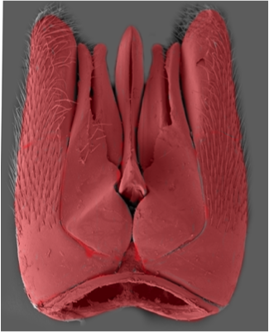
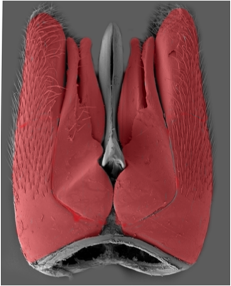
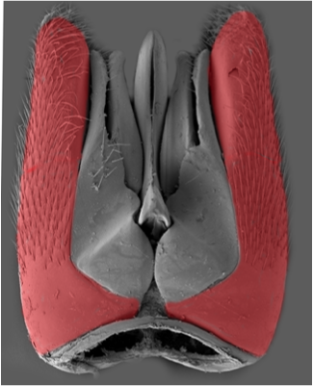
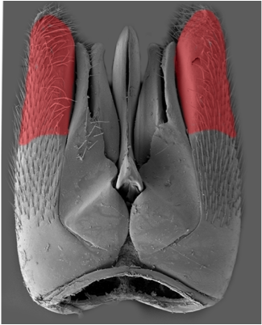
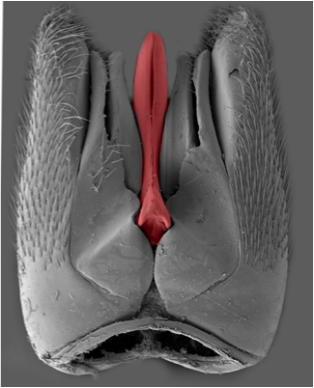
And even when we do, we don’t know what we’re talking about
paramere?
Notes:
Image courtesy of Matt Yoder
But because we have no single reference glossary the result is millions of statements that are not obviously related
here is the male genitalia of a gasteruptiid wasp.
these 5 different structures here have each been labeled "paramere" - by different people, studying different hymenopteran lineages

Slide 5
Controlled vocabularies

Slide 6


What is a Controlled Vocabulary?
Definition:
Any closed, prescribed list of terms
Key Features:
Terms are not usually defined
Relationships between the terms are not usually defined
Simplest form is a list
CV of wines:
Pinot noir
Red
Chardonnay
Chianti
Bordeaux
Riesling
…
Notes:
Another example would be the map locations list at the end of your Gazeteer.

Slide 7
What is a Hierarchical CV?
Definition:
Any controlled vocabulary that is arranged in a hierarchy.
Key Features:
Terms are not usually defined
Relationships between the terms are not usually named or defined
Terms are arranged in a hierarchy
Taxonomy of wines:
Red
Merlot
Zinfandel
Cabernet
Pinot Noir
White
Chardonnay
Pinot Gris
Riesling

Slide 8
What is a Hierarchical CV?
Definition:
Any controlled vocabulary that is arranged in a hierarchy
Key Features:
Terms are not usually defined
Relationships between the terms are not usually named or defined
Terms are arranged in a hierarchy
Taxonomy of wines:
Red
Merlot
Zinfandel
Cabernet
Pinot Noir
White
Chardonnay
Pinot Gris
Riesling
* Taxonomy – a hierarchical CV in which hierarchy = classification

Slide 9
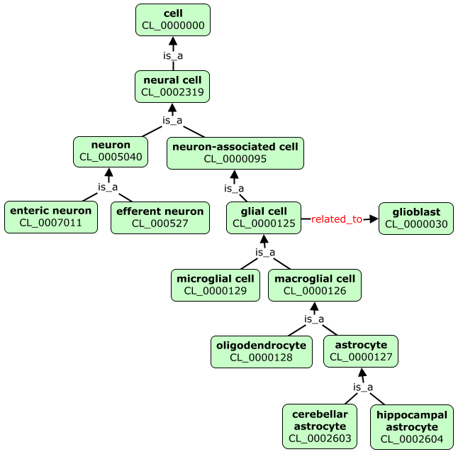
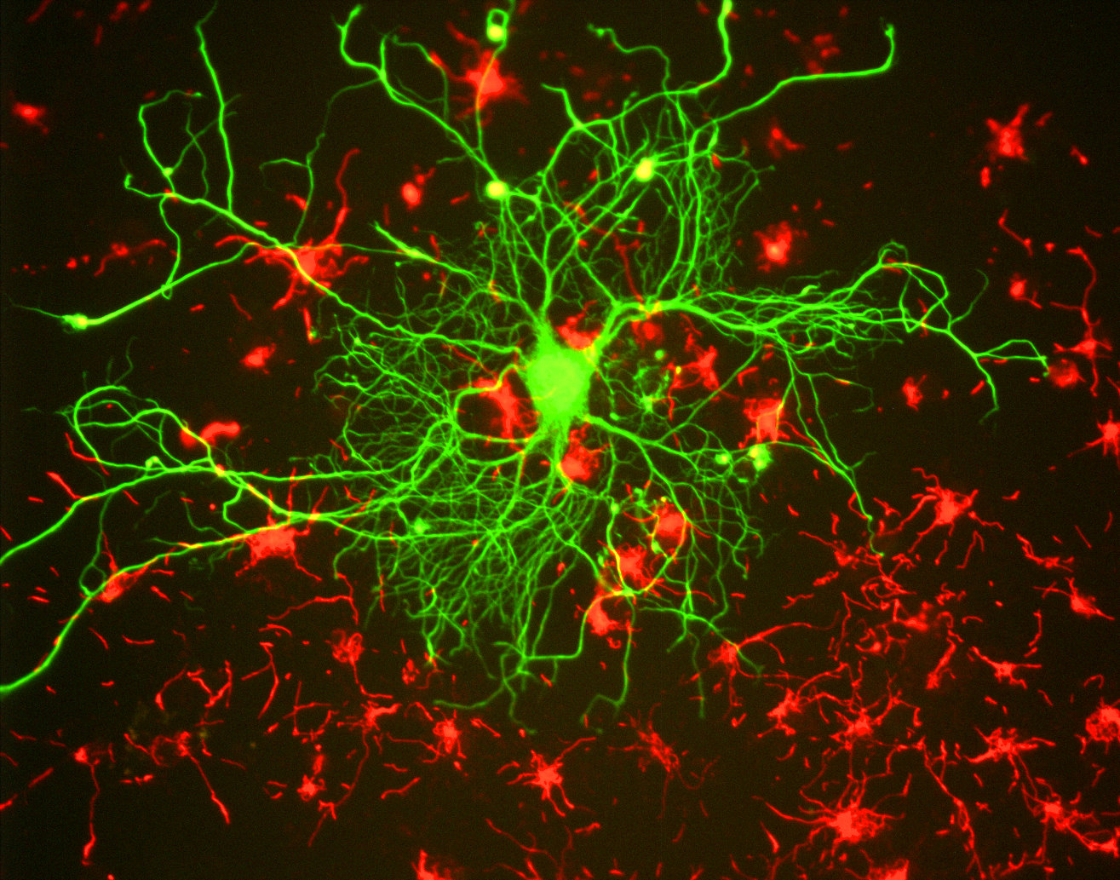
Example taxonomy (classification hierarchy)
Notes:
Image credit: https://en.wikipedia.org/wiki/Neurofilament

Slide 10
Hierarchical Query Expansion
Genes expressed in glial cells
Glial cell 20
Macroglial cell 15
Microglial cell 10
Query ‘glial cell’ without hierarchy
Results = 20
Glial cell 20
Macroglial cell 15
Microglial cell 10
Query ‘glial cell’ with hierarchy
Results = 45

Slide 11
Being precisely vague
Ontologies give allowing annotation at varying levels of precision:
Maybe the entity being annotated
is a subtype of glial cell, but you don’t know which, you can just annotate with ‘glial cell’

Slide 12
Polyhierarchy
Taxonomy of wines
Color
Red
Pinot noir
Chianti
Bordeaux
White
Chardonnay
Riesling
Region
Bordeaux
Chianti
Varietal
Pinot noir
Chardonnay
Reisling
CV of wines:
Pinot noir
Red
Chardonnay
Chianti
Bordeaux
Riesling
…
These are all different types:
color
location
varietal

Slide 13
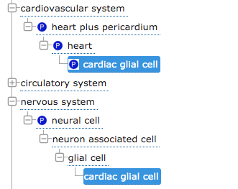
Multiple relationship types are useful for grouping and being precisely vague

Slide 14
What is an Ontology?
Definition:
A queryable store of knowledge;
A classification
Key Features:
Terms are defined
Terms are richly annotated:
Textual definitions; references; synonyms, links, cross-references
Relationships between terms are defined, allowing logical inference and sophisticated queries as well as graphs
Terms are arranged in a classification hierarchy
Expressed in a knowledge representation language such as RDFS, OBO, or OWL
Examples:
Gene Ontology, Uberon, Cell Ontology, EFO, SNOMED

Slide 15
The non-logical parts of an ontology are important !
Terminology can be ambiguous
paramere?
… so text definitions, references, synonyms and images are key to helping users understand the intended meaning of a term
Notes:
Image courtesy of Matt Yoder
But because we have no single reference glossary the result is millions of statements that are not obviously related
here is the male genitalia of a gasteruptiid wasp.
these 5 different structures here have each been labeled "paramere" - by different people, studying different hymenopteran lineages

Slide 16
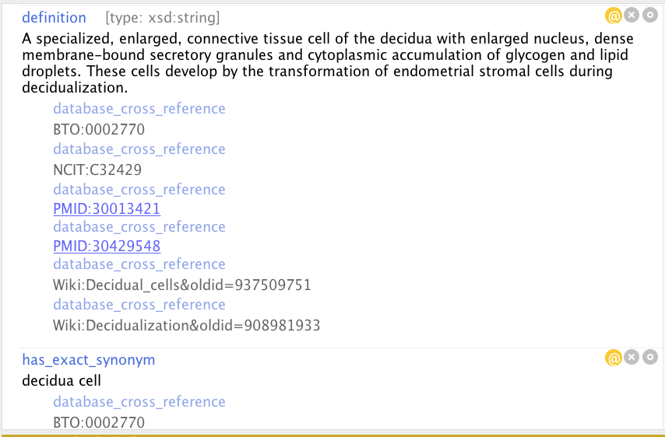
The non-logical parts of an ontology are important !
A descriptive, accessible definition
Definition partly mined from these other ontologies
Supporting references
Supporting literature
Jargon Buster:
The properties used here (e.g. definition), are called Annotation Properties in OWL
Link to Wikipedia page version used
Synonyms (with references)
Notes:
Add nice example term here

Slide 17
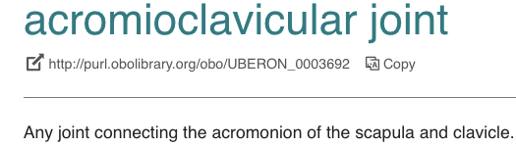
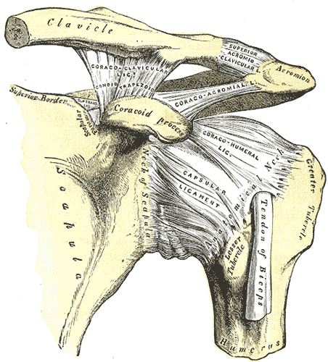
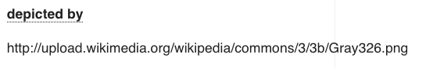
The non-logical parts of an ontology are important !
Linked images are a great way to make the meaning of terms clear.
Display of linked images is currently broken on OLS - should be fixed soon

Slide 18
A brief diversion on identifiers

Slide 19
Why you need non meaningful identifiers
If you ever need to change the names of your terms, you're going to need identifiers that stay the same when the term name changes
e.g. microgilal cell, also known as: hortega cell; microglia, microgliocyte, brain resident macrophage.
microglial cell has the unique identifier:
CL_0000129 (AKA CL:0000129)
CL_0000129 & CL:0000129 are short ways of referring to
http://purl.obolibrary.org/obo/CL_0000129
This IRI is a unique, resolvable identifier on the web.

Slide 20
The PURL system
A group of ontologies - loosely co-ordinated through the OBO Foundry, have standardised their IRIs, e.g.
http://purl.obolibrary.org/obo/CL_0000129 - A term in the cell ontology
http://purl.oblibrary.org/obo/cl.owl - The cell ontology
Jargon Buster
IRI: Internationalised Resource Identifier - a URI that can use characters in multiple languages
URI: Unique Resource Identifier - is a string of characters, following a standard specification, that unambiguously identifies a particular (web) resource.
URL: Uniform Resource Locator - a web-resolvable URI

Slide 21
Building scalable ontologies

Slide 22

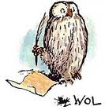
OWL 2
W3C recommendation (2009)
A formal language (description logic) for writing ontologies and knowledge bases
Automated classification
Error (consistency) checking
Transparent query language (OWL Manchester Syntax)
Web native: All identifiers are IRIs (for classes, relations, ontologies…)
Mappings: OBO <-> OWL
Large and growing ecosystems of
Open-source software
Ontologies and schemas for biology representing:
Anatomy & Cell types (CL, Uberon, DAO, ZFA...), Biological Processes & Cell Components (GO), Chemicals (ChEBI), phenotypes (uPheno, MP, XPO, DPO...)

Slide 23
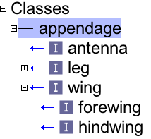
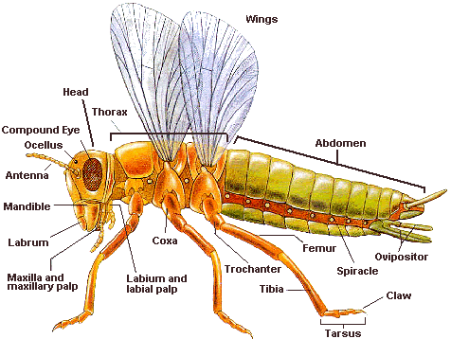
What is an ontology ?
A classification
appendage
antenna
wing
forewing
hindwing
OWL: hindwing SubClassOf wing
OBO: hindwing is_a wing
Notes:
Make graph of hierarchy

Slide 24
part_of some ‘thoracic segment’
wing
leg
OWL: ‘leg’ SubClassOf part_of some thoracic segment
OBO: 'leg'; relationship: part_of thoracic segment
English: all (insect) legs are part of a thoracic segment

Slide 25
part_of some ‘thoracic segment’
wing
leg
existential quantifier
Jargon Buster
subclass restriction: ‘leg’ SubClassOf part_of some thoracic segment
Relation, AKA OWL ObjectProperty
Anonymous class expression

Slide 26
✔
‘wing’ SubClassOf part_of some thoracic segment
‘thoracic segment’ SubClassOf has_part some ‘wing’
✗
has_part some
wing
thoracic segment
✗

Slide 27

‘claw’ SubClassOf connected_to some ‘tarsal segment’
‘tarsal segment’ SubClassOf connected_to some claw
✔
✗
connected_to some
‘claw’
claw
tarsal segment
tarsal segments
✗

Slide 28
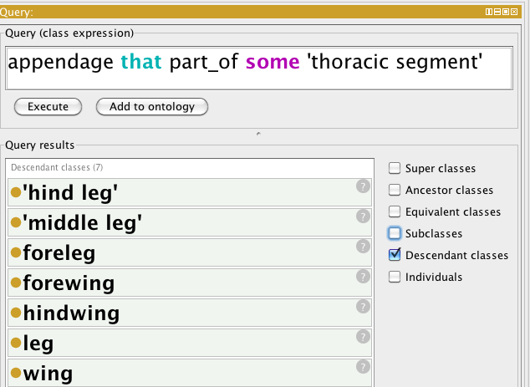
Relationships store knowledge in query-able form
part_of some ‘thoracic segment’
forewing
leg
wing
hindwing
antenna
appendage
Notes:
Make screen shot for this

Slide 29
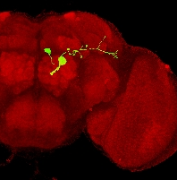
An ontology is a classification
There are lots of useful ways to classify stuff
A single neuron may be classified by
structure
pseudo-bipolar
electrophysiology
spiking
neurotransmitter
cholinergic
sensory modality
secondary olfactory neuron
pattern of innervation within the brain
antennal lobe projection neuron, mushroom body extrinsic neuron
Lineage:
descended from neuroblast ALad1
DL1 adPN
VGlut-F-200455

Slide 30
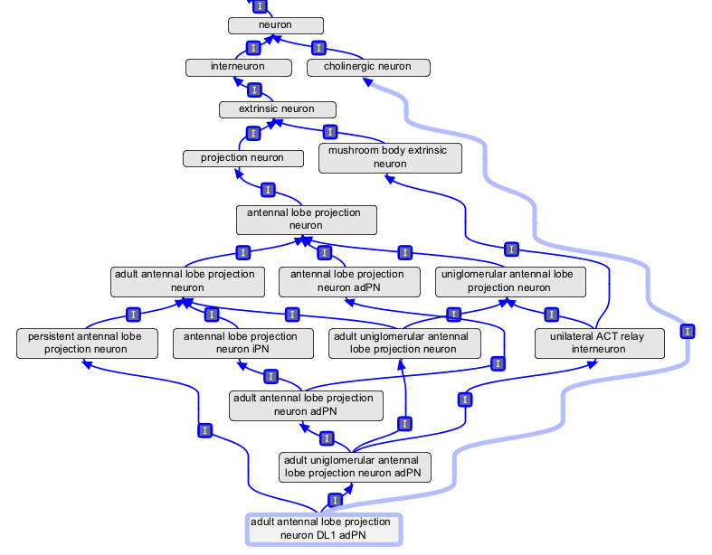
Manually maintained multiple inheritance doesn’t scale

Slide 31
Problem: Managing multiple inheritance classification
Maintaining multiple inheritance classifications by hand
Doesn’t scale
When adding a new class how are human editors to know
all of the relevant classifications to add?
how to rearrange the existing class hierarchy
Is bad for consistency:
Reasons for existing classifications often opaque
Hard to check for consistency with distant superclasses
Doesn’t allow for querying
A formalized ontology can be queried for classes with arbitrary sets of properties. A manual classification can not.

Slide 32
The knowledge an ontology contains can be used to automate classification
English: Any sense organ that functions in the detection of smell is an olfactory sense organ
OWL Manchester Syntax
antennal sense organ
EquivalentTo ‘sense organ’
that
capable_of some ‘detection
of smell’
olfactory
sense
organ
capable_of some detection of smell
sense organ
GO
Term

Slide 33
sense organ
capable_of some
detection of smell
nose
nose
olfactory
sense
organ
nose
olfactory
sense
organ
capable_of some detection of smell
sense organ

Slide 34
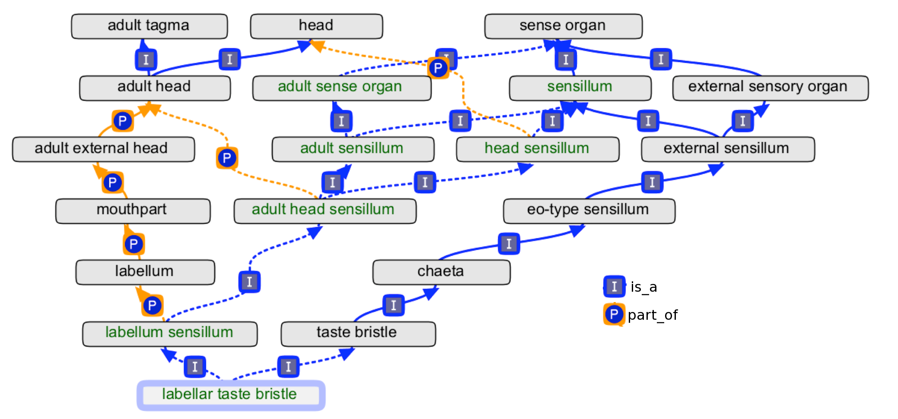
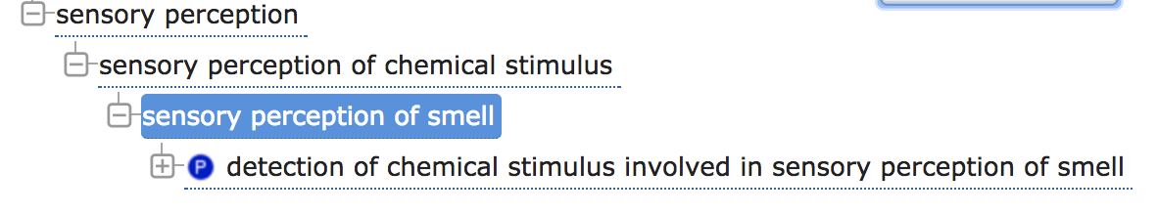
Manually maintaining an ontology with multiple classification schemes is hard
So automate what you can and leverage the work of others

Slide 35
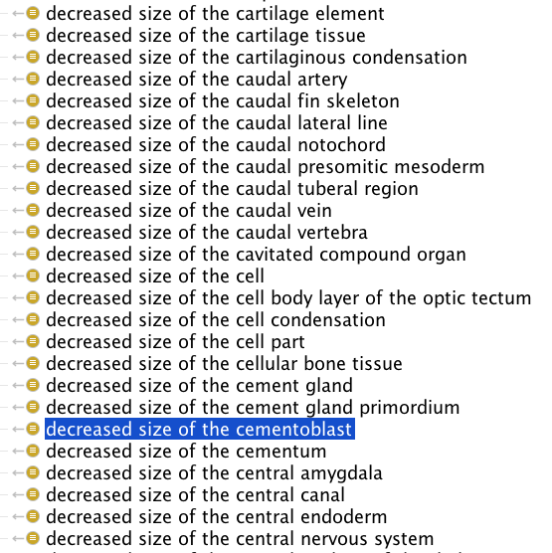
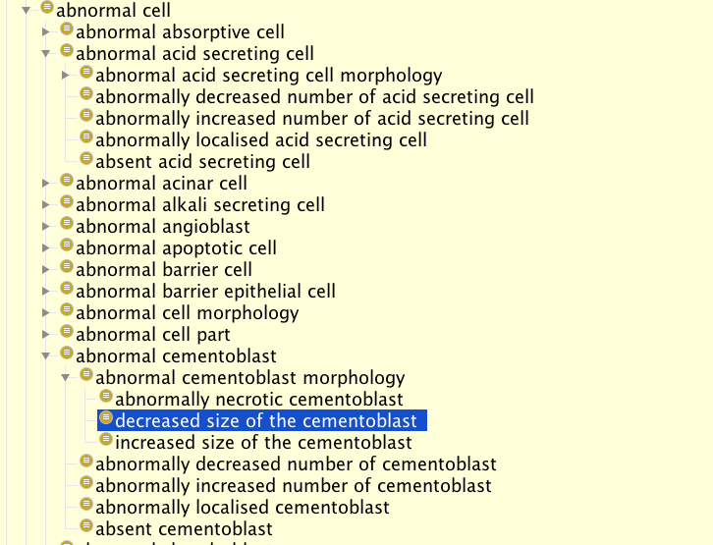
Xenopus Phenotype ontology - 100% reasoner driven
https://github.com/obophenotype/xenopus-phenotype-ontology

Slide 36
Design patterns for representing neuro-anatomy
Standard logic for spatial reasoning; reasoning about function.
multi-scale: from brain regions and tracts to single synapses
subject | relation | (quantifier) object
DL1 adPN | overlaps (has some part in)
 | . has synaptic terminal in
 | . . has presynaptic terminal in | some lateral horn
 | . . has postsynaptic terminal in | some glomerulus DL1
 | . fasciculates with | some iACT
 | . has soma location | some cortex of antennal lobe
 | synapsed by | some OR10a
 | develops from | some ALad1 neuroblast
 | . directly develops from
 | capable of | some acetylcholine secretion, neurotransmission
 | capable of part of | some sensory perception of smell
A strategy for building neuroanatomy ontologies. Osumi-Sutherland et al., 2012
Bioinformatics 28(9) 1262–1269.

Slide 37
Tune in next time for
More on design patterns
Automatically generating terms from template

Slide 38
Acknowledgments
Nicole Vasilevsky (OSHU) Alex Diehl (Buffalo), Nico Matentzoglu
Chris Mungall (LNBL), Melissa Haendal (OSU), Jim Balhoff (RENCI), James Overton - slides, ideas & discussions
Terry Meehan - who edited CL more than anyone
Helen Parkinson (EBI)
Michael Ashburner

